Slide 1

Train Ticket Generation Web Application Batch-85
Done By:
Akshatha Chandraraju
Anil Ramesh
Abhinab Gupta
Rishav Kr Chourasia
Sachin Mural

Slide 2
CONTENTS
●CASE STUDY OVERVIEW ●BUSINESS REQUIREMENT ●DESIGN ●SOFTWARE REQUIREMENT

Slide 3
Case Study Overview
This case study involves generating a train ticket and printing the ticket to a file. The application should take train number and passenger details
The details of the train should be stored in a database. The train details to be stored in database are train number, train name, source station, destination station, and ticket price. The train details should be fetched from the database using the train number provided by the user.

Slide 4
Case Study Overview
The passenger name, age and gender should be accepted from the user. The application should generate a train ticket using the train details and passenger details. The generated ticket should contain the following details:
PNR number, travel date, train number, train name, source station, destination station.
Name, age, gender and ticket fare for each passenger.
Total ticket price.
The generated ticket should be written to a File.

Slide 5
BUSINESS REQUIREMENT
The ticket Fare for each passenger is calculated using the following rules:
For age < = 12, fare is 50% of ticket price regardless of gender
For age > = 60, fare is 60% of ticket price regardless of gender
For Females, 25% discount on the ticket price
The file name for storing the generated ticket should be the PNR Number.

Slide 6
BUSINESS REQUIREMENT
The Trains should be fetched from database using train number.
Travel date should be after current Date.
The PNR number should be auto-generated by adding first character of source station, first character of destination station, travel date(yyyy/mm/dd) and a running counter starting from 100.
Example: PNR for train from Bangalore to Mumbai with travel date 21/01/2017 would be BM_20170121_100

Slide 7
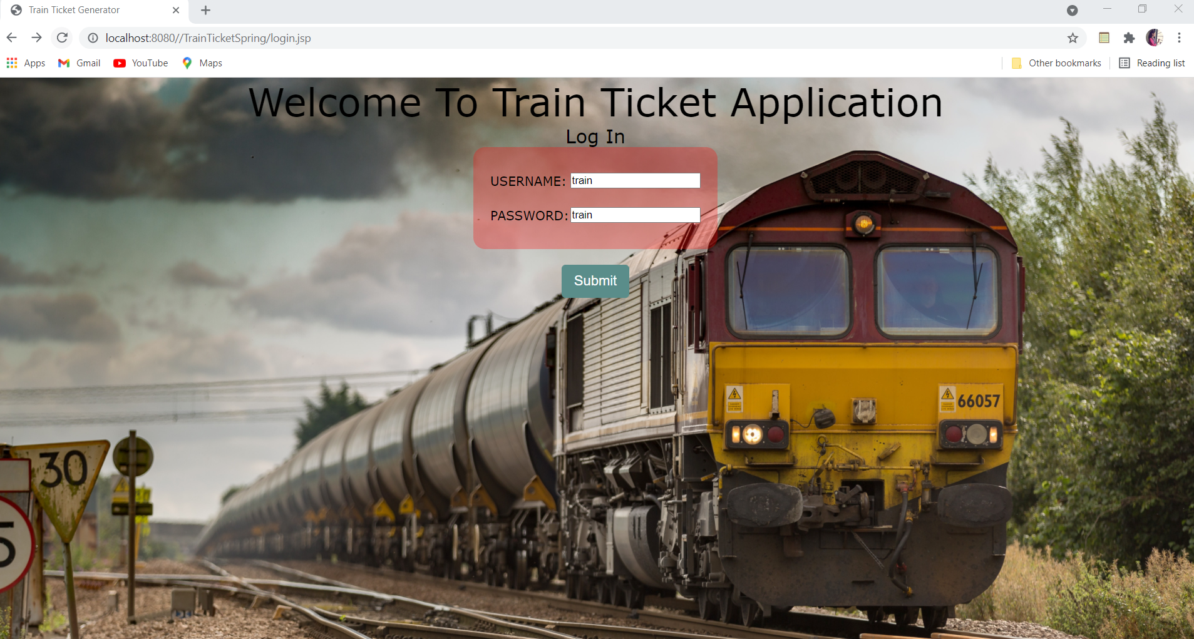
LOGIN

Slide 8
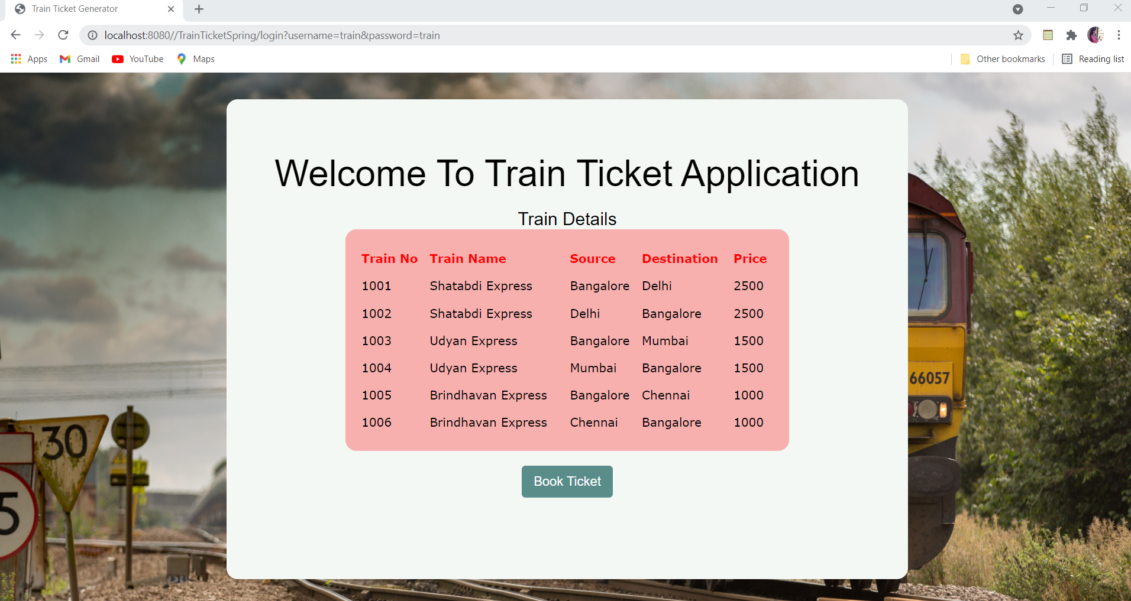
TICKET DETAILS

Slide 9
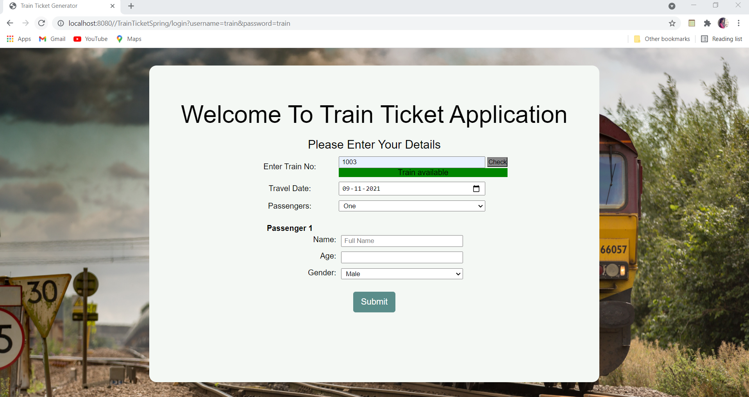
USER DETAILS

Slide 10
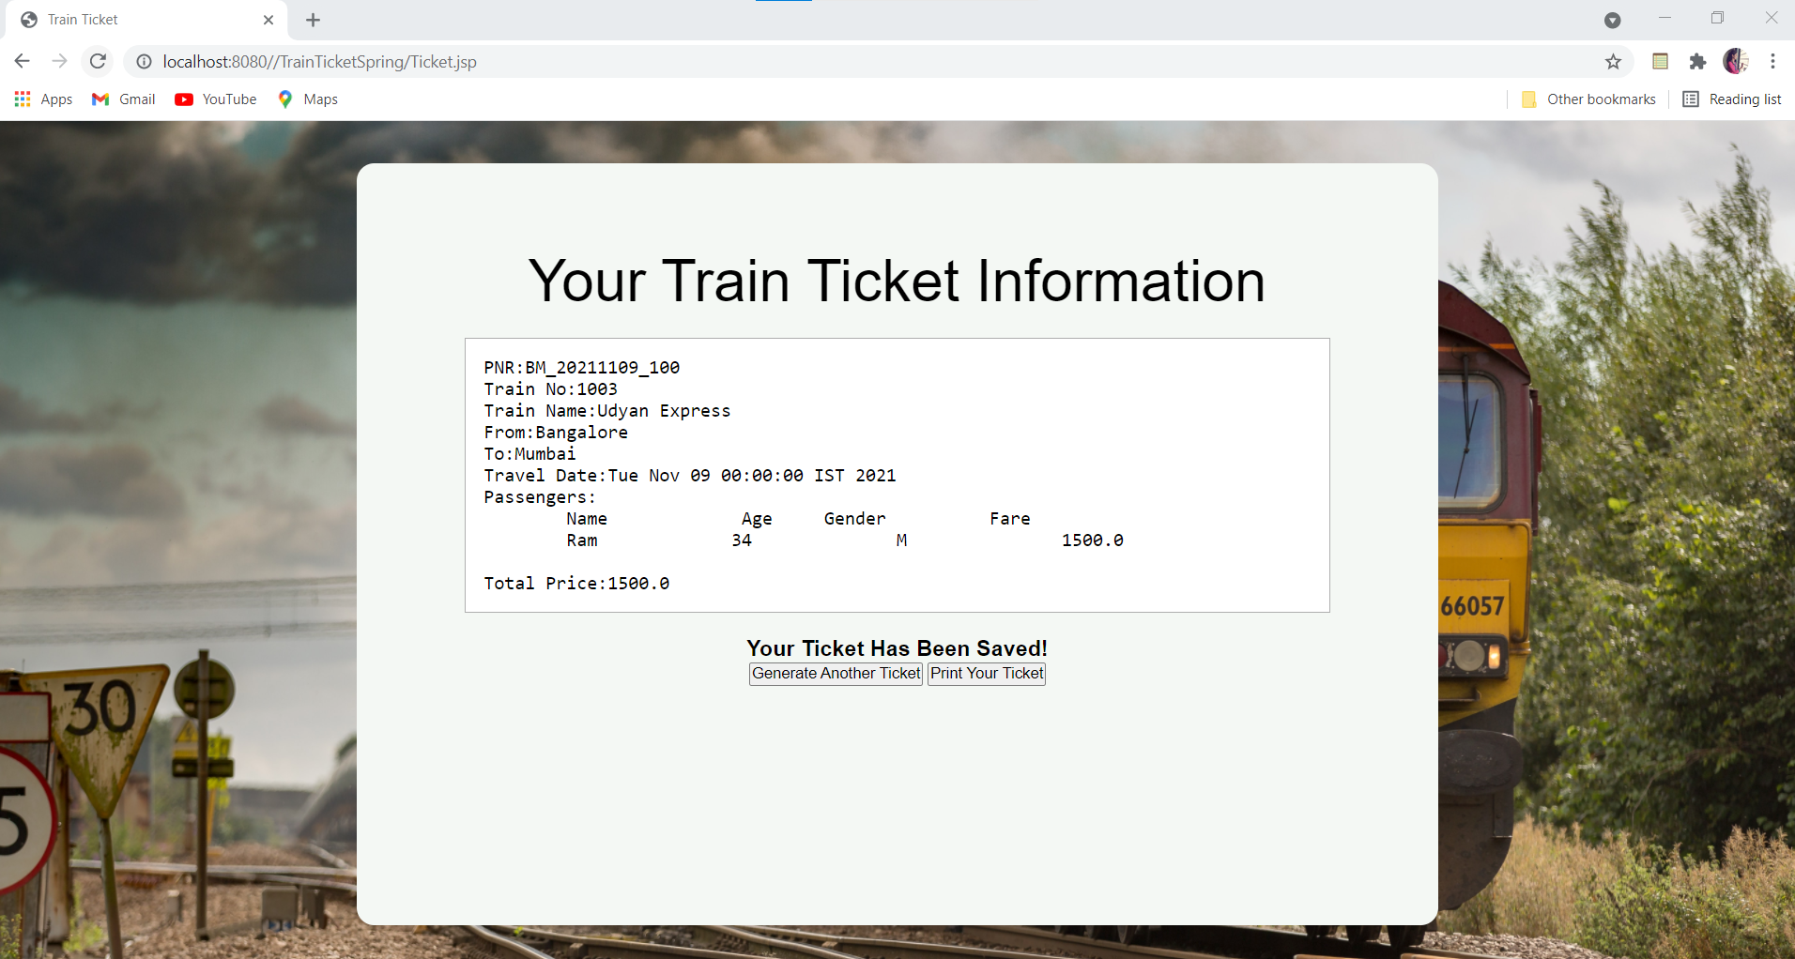
GENERATED TICKET

Slide 11

SOFTWARE REQUIREMENT
IDE
IntelliJ IDEA
TOOLS
Java
MySQL
JavaScript
Html, CSS
Jsp
SpringMVC

Slide 12

THANK YOU

